Slide 1

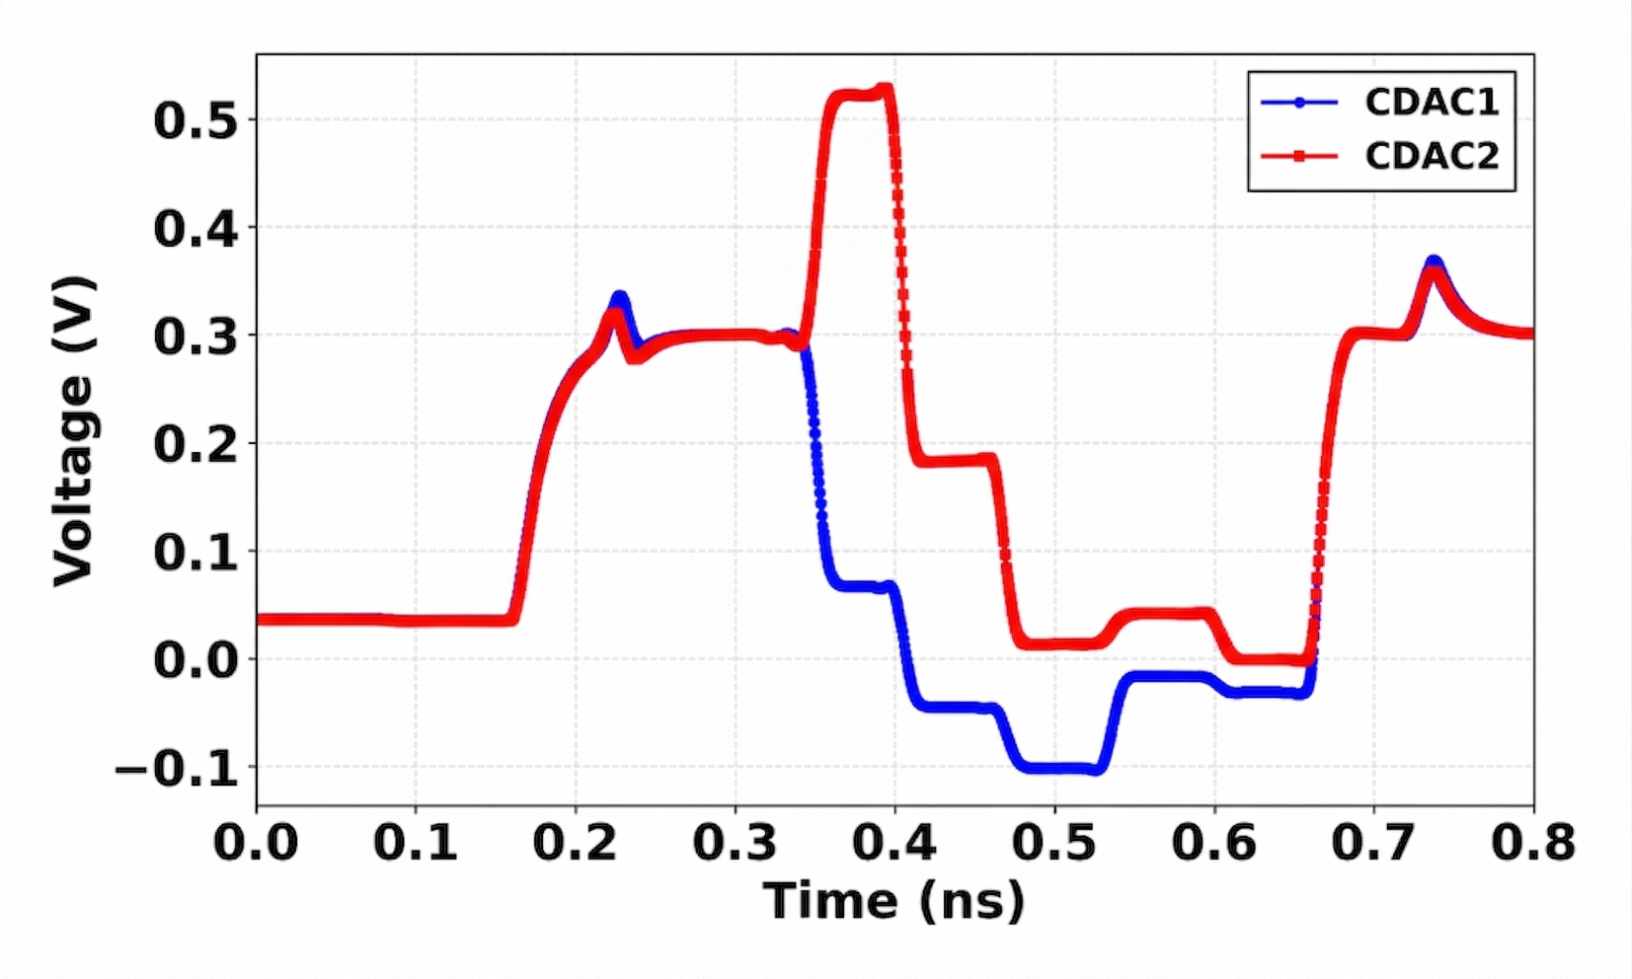
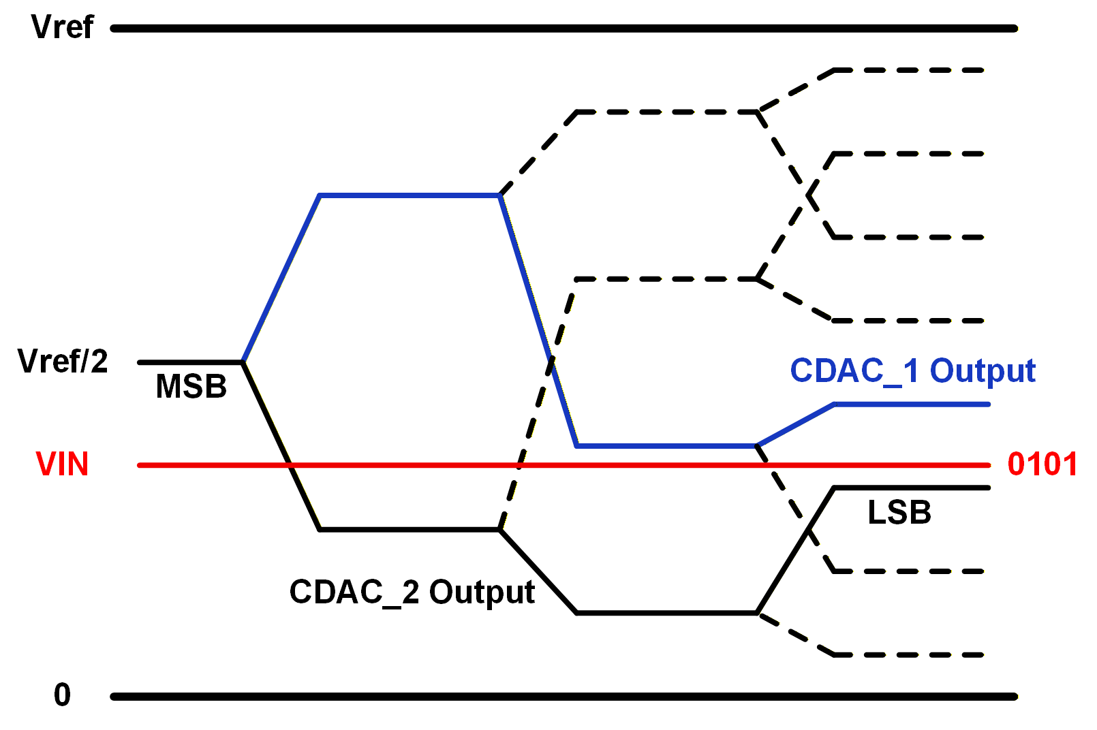
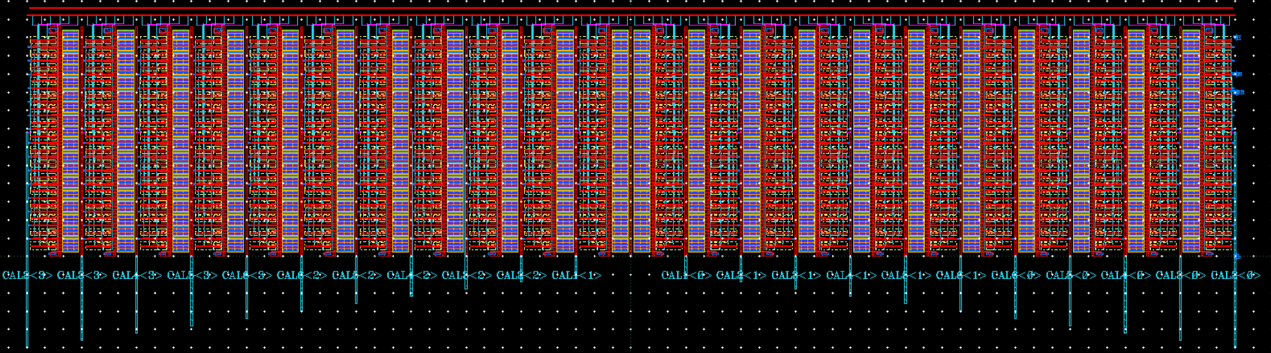
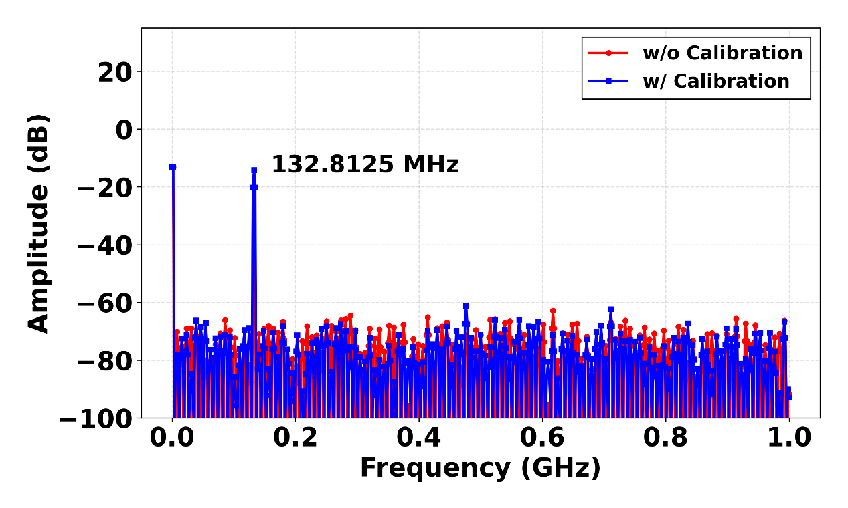
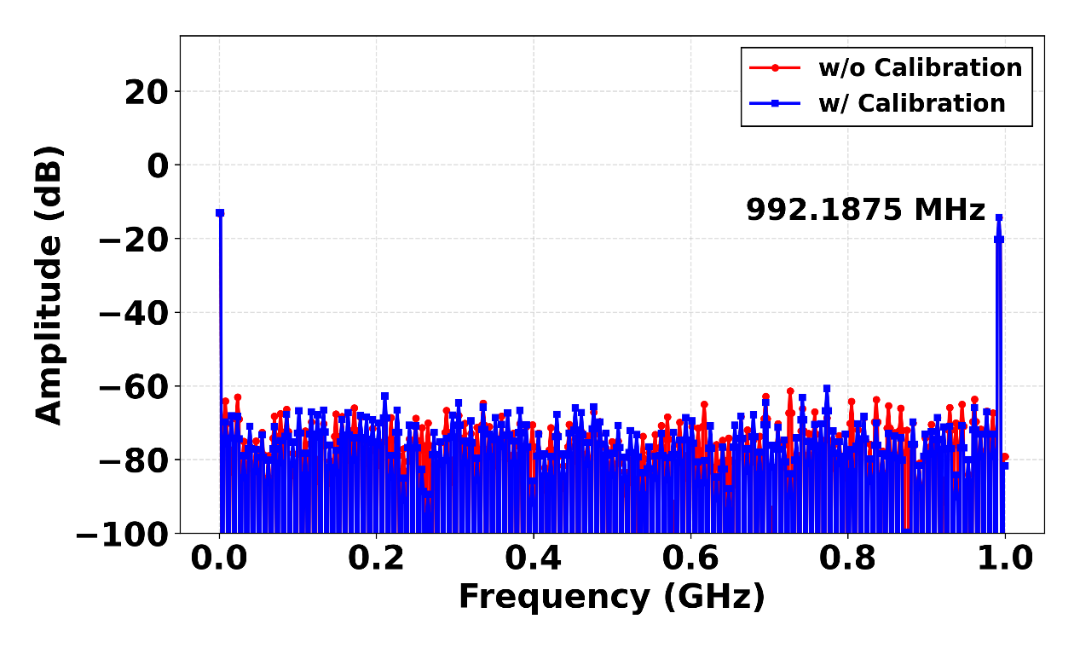
Comparator Offset Calibration for 6-bit Single-Channel Speculative Loop-Unrolled SAR ADC in 28-nm CMOS
Dong-Un Jin¹ and Min-Seong Chooª
¹School of Electrical Engineering, Hanyang University, Ansan, South Korea
ªSchool of Electrical and Electronic Engineering, Yonsei University, Seoul, Soutth Korea
Abstract: This chip implements a single-channel speculative loop-unrolled SAR ADC in 28-nm CMOS for high-speed conversion without time interleaving. Comparator offset calibration compensates for mismatch among parallel comparators, improving conversion accuracy and mitigating SNDR degradation.
그림
그림
Motivation
Top Architecture
Conventional Loop-unrolled SAR ADC
Top architecture employs speculative switching to reduce CDAC settling time.
Conventional SAR: speed limited by sequential loop delay.
Comparator/logic delay → bottleneck.
Loop-unrolled SAR: removes loop delay, boosts speed but CDAC Settling time remains.
그림
그림
Timing Advantage
CDAC Switching Operation
(a)
(b)
(a)
(b)
(a) Conceptual CDAC settling behavior.
(b) Timing comparison with speculative CDAC preparation.
(a) Waveform of speculative CDAC switching.
(b) Binary Search Operation with Speculative CDAC Switching at 4-bit.
그림
그림
Comparator with Offset Calibration
RDAC Array
Calibration logic without extending the critical timing path
Calibration for both CDAC1 and CDAC2 branches
Modified double-tail comparator for reduced kickback noise
A 6-bit RDAC array generates programmable calibration voltages.
Its outputs are applied to each comparator branch for offset trimming through I2C control.
This supports accurate comparator offset calibration.
그림
그림
Simulation Results
TOP Design
(a)
(b)
Maintains ENOB at both (a) low-frequency and (b) Nyquist inputs
Calibration enables improved SNDR/ENOB consistency
ENOB at Low Frequency: 5.21 bits
ENOB at Nyquist Frequency: 4.68 bits
Conclusion: This work presents a single-channel speculative loop-unrolled SAR ADC in 28-nm CMOS that reduces the CDAC-settling bottleneck through speculative switching and improves accuracy with comparator offset calibration. Simulation results show 5.21 bits ENOB at low frequency and 4.68 bits ENOB at Nyquist, validating the proposed high-speed single-channel SAR ADC.
Acknowledgement: The chip fabrication and EDA tool were supported by the IC Design Education Center(IDEC), Korea.

